Slide 1

Customer churn Prediction
2022 by Nordea. All rights reserved.
Copyright
By Sushant Kumar Srivastava
Confidential

Slide 2
Introduction
Objective:
To build to Model to predict whether a customer will stay or exit (churn) with the highest accuracy.
Data Source:
Dummy Dataset provided contains 10,000 rows with no null values.
It contains various information of employees related to their demographic and other personal banking information.
Analysis Structure:
Exploratory Data Analysis.
Introducing SMOTE for class im-balancing (Synthetic Minority Over Sampling Technique).
Building pipelines for different models(Randomforest , SVM, Neural Networks).
Also using Cross Validation and Grid Search techniques.
Comparing the predictions and choosing which models generalises well.
Ideas to the Retail Banking Management Team:
2

Slide 3
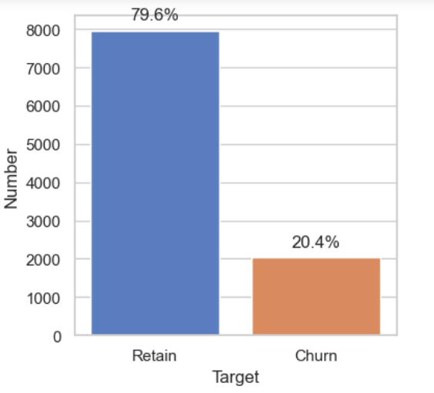
Exploratory Data Analysis (EDA) on the Dataset :
I first started with checking the data with null values and the dataset is very clean and contain no null values.
Then I moved ahead with Feature Engineering and removing the features not relevant for prediction :
Row Number
Customer ID
Surname
Let’s check the Target Feature Distribution :
The chart depicted above illustrates the distribution of the target variable, indicating that the percentage of Churn among bank customers is 20.4%. This suggests an imbalance in the data related to the target variable.
To address this I have used SMOTE in the machine learning models.
3

Slide 4
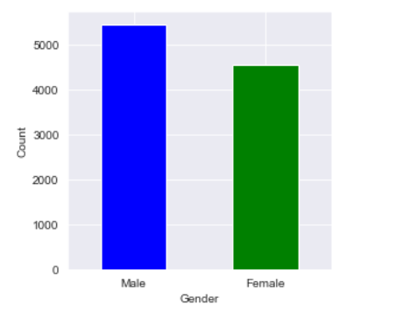
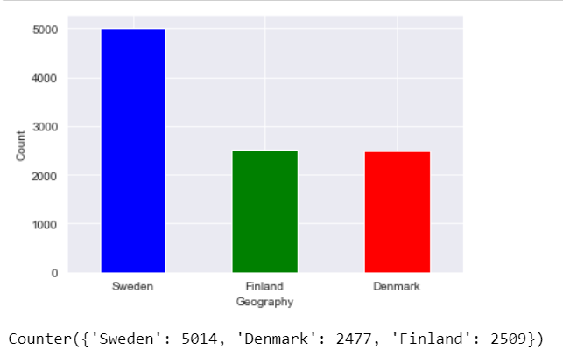
Distribution of Features :
After analysing the features that can be divided into categories like Gender and Geography.
There are more males than females.
Sweden accounts for 50% where as, Finland and Denmark accounts for 25% of the customers.
4

Slide 5
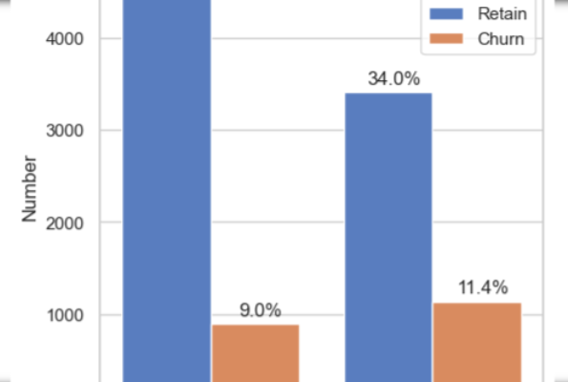
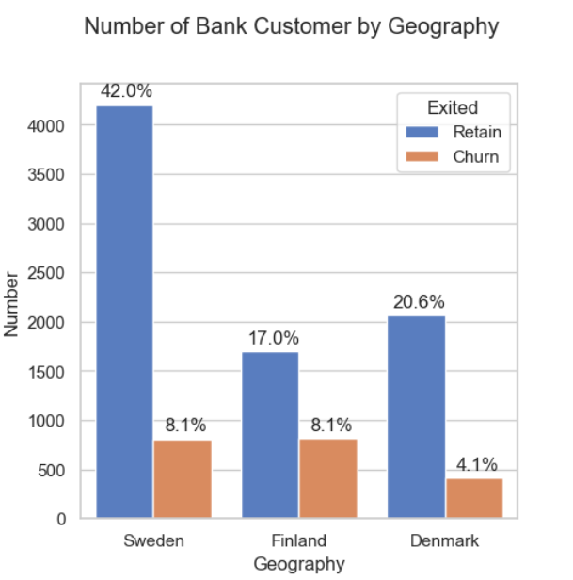
Distribution of Features :
After analysing the features that can be divided into categories like Gender and Geography.
The chart above illustrates the distribution of the target variable based on 'Gender. Among bank customers, females exhibit the highest churn rate at 11.4%, surpassing males who have a churn rate of 9%.
The chart above displays the distribution of target variables categorized by geography. Specifically, both Sweden and Finland demonstrate a churn percentage of 8.1%, while Denmark exhibits a churn percentage of 4.1%.
5

Slide 6
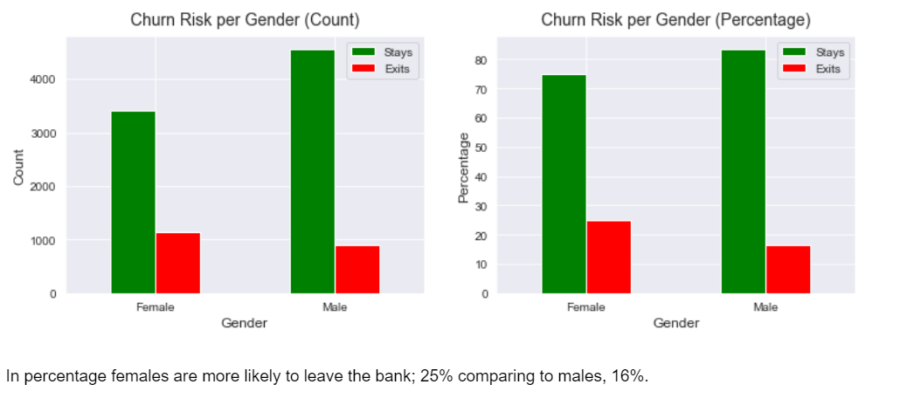
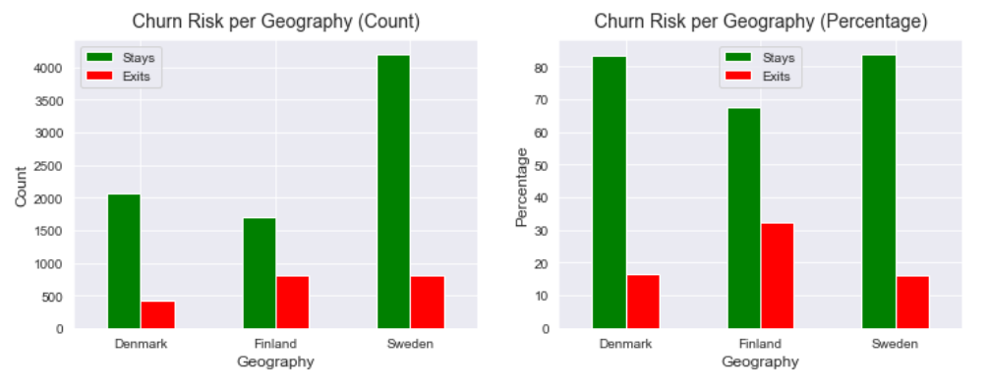
Churn analysis by Features :
I deep downed into analysing the segmentation of churn by gender and geography.
There are 25% female customers who are leaving the bank,16% males.
Finland has the least no of customer and by far the highest churn rate.1 of 3 finnish customers are leaving the bank.
6

Slide 7
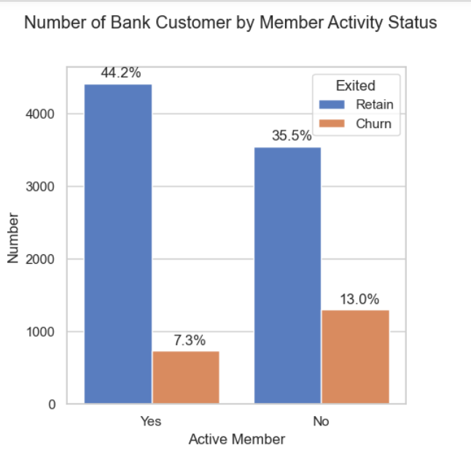
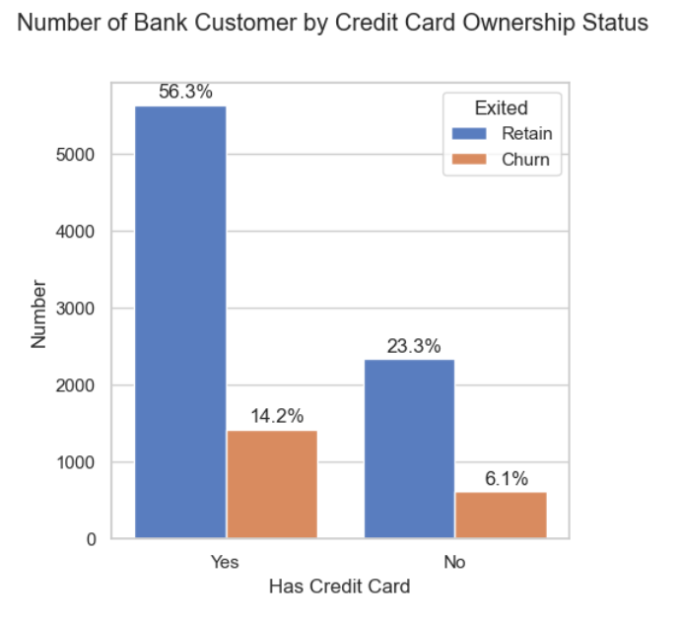
Churn analysis by Features :
The graph above depicts the distribution of the target variable based on 'IsActiveMember.' Notably, bank customers who are not active members exhibit a higher churn percentage, totaling 13%, compared to active customers.
The graph above illustrates the distribution of target variables categorized by 'HasCrCard.' Notably, bank customers possessing a credit card have the highest churn rate at 14.2%, exceeding customers without a credit card, who have a churn percentage of 6.1%.
7

Slide 8
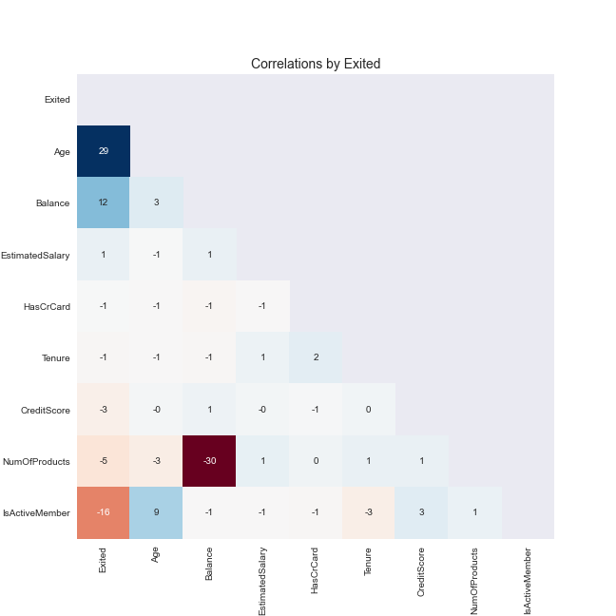
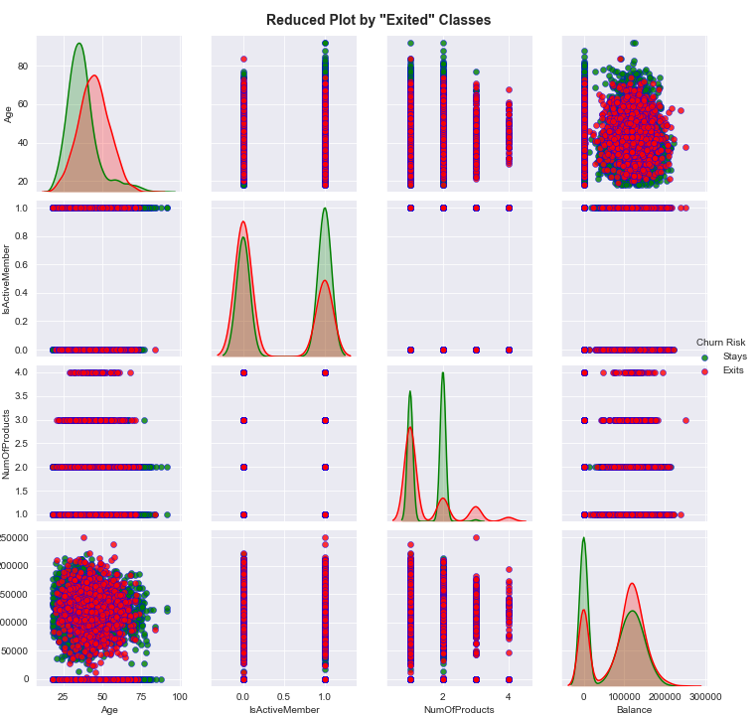
Some Inferences from plots :
The correlation plot seems to show weak positive correlation with age , balance and very weak negative correlation with products and membership.
Also, the density plot shows that older customer more probable of leaving the bank.
8

Slide 9
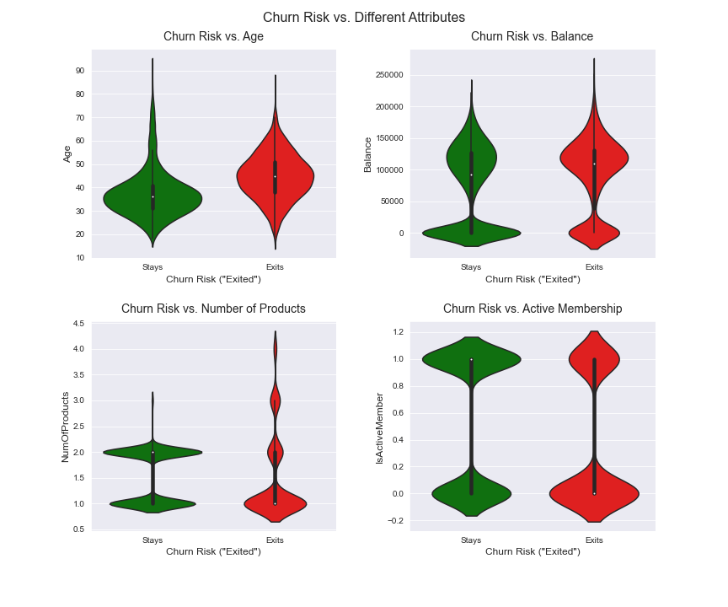
Some Inferences from plots :
On the other hand , the use of violin plots also confirms that:
Older customers are most likely to leave the bank.
Customers with more products are also likely to leave
9

Slide 10
Some Inferences from plots :
Also, the box plots plotted between several features tells us the following:
Churning customers are typically older than those who remain with the bank.
No notable distinctions in median credit score or tenure are apparent between customers who churn and those who stay.
A considerable portion of customers who churn still maintains a substantial balance in their bank accounts.
Neither estimated salary nor the number of products appears to exert a significant influence on customer churn.
Feature Engineering: I also tried to explore and create additional feature to gain more insights.
Credit Score to Age Ratio: It appears that customers who are churning tend to have a smaller credit score-to-age ratio.
Balance to Salary Ratio: It appears that customers with a higher balance salary ratio churn more than those with a lower ratio.
10

Slide 11
ML Models used Churn Prediction :
I have considered 4 types of models for the prediction undertaking SMOTE as a technique to handle imbalanced class.
SVM without SMOTE.
SVM with SMOTE.
Random Forest.
Neural Networks.
From the evaluated machine learning models , i found that the Neural Network Model performs with the best accuracy of around 86% ,also producing the least False negatives of around 2.11% indicating it predicts the best in case of a customer will churn and they actually do.
11

Slide 12
Recommendations/Ideas to the Retail Banking Management Team :
Address Gender Disparities:
Acknowledge the gender imbalance in the customer base.
Consider implementing targeted marketing or promotions to attract and retain more female customers.
Geographic Targeting:
Recognize the varying churn rates across different countries.
Devise localized strategies for customer retention, especially focusing on Finland where the churn rate is notably high.
Focused Retention Strategies:
Design initiatives targeting older customers, as they exhibit a higher likelihood of churning.
Engagement of Inactive Members:
Develop campaigns to re-engage inactive members.
Incentivize active participation to reduce the higher churn rate observed among inactive customers.
Credit Card Usage Insights:
Analyze the factors contributing to the high churn rate among credit card users.
Consider refining credit card offerings or introducing loyalty programs for this customer segment.
12

Slide 13
Recommendations/Ideas to the Retail Banking Management Team :
Product Portfolio Evaluation:
Assess the product offerings and their alignment with customer needs.
Identify and refine products that may contribute to customer churn.
Credit Score and Tenure Analysis:
Explore further the lack of distinctions in credit score and tenure between churned and retained customers.
Conduct customer feedback surveys to understand factors beyond numerical metrics influencing churn.
Balance Retention Strategies:
Develop personalized approaches to retain customers with substantial account balances.
Communicate additional benefits or services that cater to the financial preferences of high-balance customers.
Regular Monitoring and Adaptation:
Establish a continuous monitoring system to track the effectiveness of implemented strategies.
Adapt approaches based on evolving customer behaviors and market dynamics.
13

Slide 14
Recommendations/Ideas to the Retail Banking Management Team :
Collaboration with Customer Support:
Foster collaboration between data analysis teams and customer support.
Utilize real-time feedback from customer interactions to refine strategies.
Promotion of Financial Literacy:
Launch educational campaigns to enhance financial literacy among customers.
Empower customers with knowledge to make informed financial decisions, potentially reducing churn.
Incentivize Customer Feedback:
Encourage customers to provide feedback on their banking experiences.
Use feedback to identify pain points and areas for improvement.
Cross-Functional Team Collaboration:
Promote cross-functional collaboration between data scientists, marketing, customer support, and product development teams.
Ensure alignment and coordinated efforts toward customer satisfaction and retention.
14

Slide 15
Further steps to improve the Model Accuracy and Performance :
Steps to Further Improve the Model (ANN):
Fine-tune Architecture:
Experiment with different hidden layer configurations.
Adjust the number of neurons in each layer for improved representation.
Optimize Learning Rate:
Fine-tune the learning rate to optimize convergence.
Implement Batch Normalization:
Introduce batch normalization layers for stable training.
Apply Dropout Regularization:
Implement dropout layers to prevent overfitting.
Explore Activation Functions:
Experiment with different activation functions for hidden layers.
Early Stopping Mechanism:
Apply early stopping to prevent unnecessary training.
15

